Slide 1
Transient Groundwater Model
Stress on system:
- Recharge (uniform & constant)
- ET (seasonal & spatially variable)
* two transient scenarios of ET
Abram Farley
Tesfa, Gebremeskel
Spring 2020

Slide 2
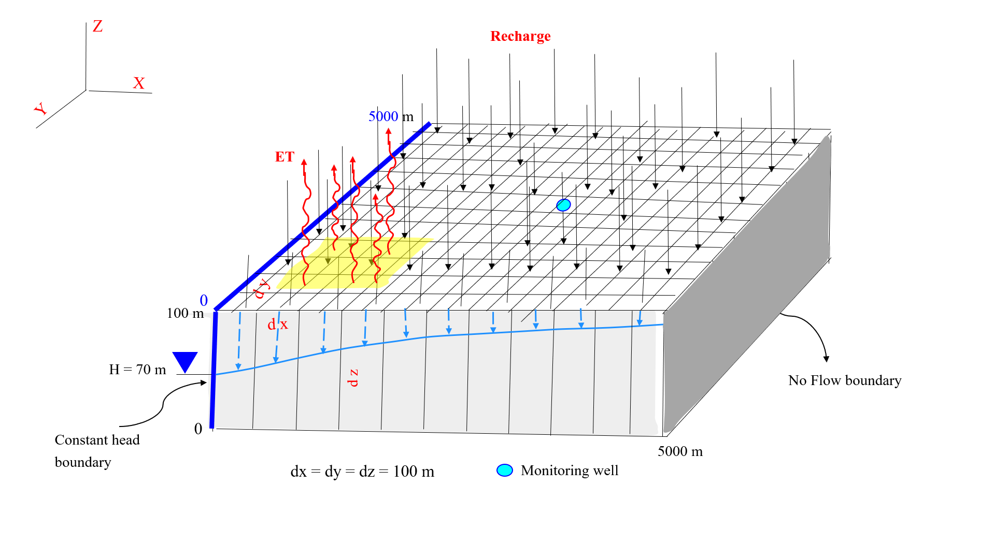

Slide 3
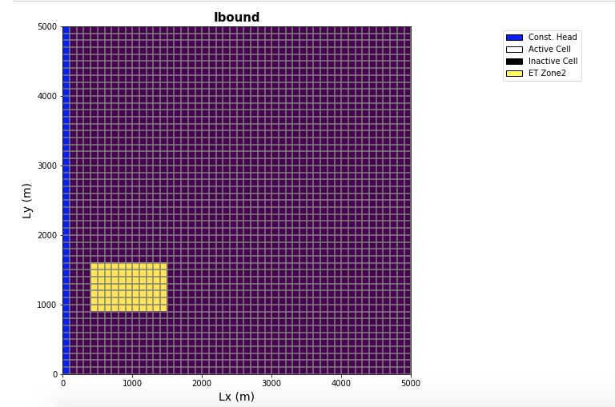

Slide 4
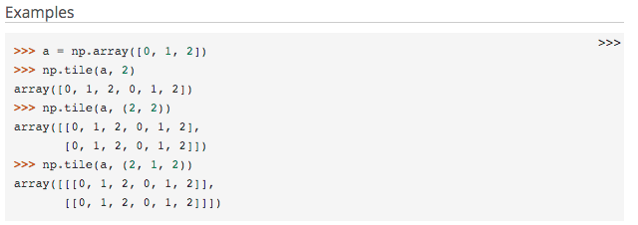
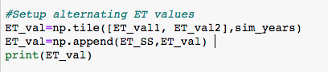
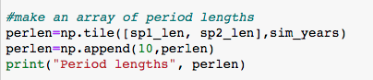
New Python Concepts
np.tile(): explain how this was used in the script

Slide 5
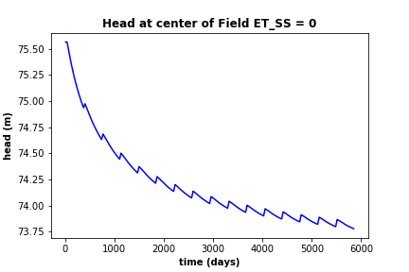
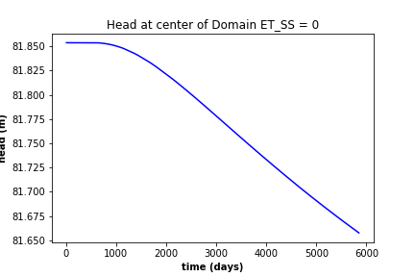
Initial Setup from Self Check
Self check plots
Downward trend of head values over time due to the initial SS solution not having any ET. Each stress period brings the system close to new SS.

Slide 6
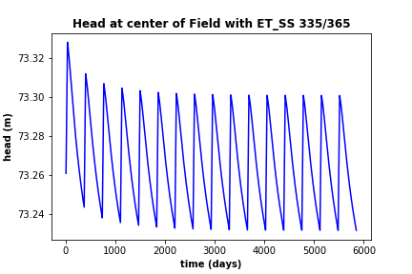
Question 1 ET_SS = 335/365*etval2 (~0.92)
stress period 1 val * 30/365 + stress period 2 val * 335/365 = 0.92

Slide 7
.

Slide 8
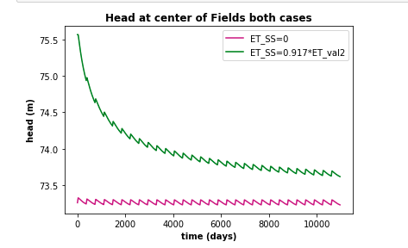
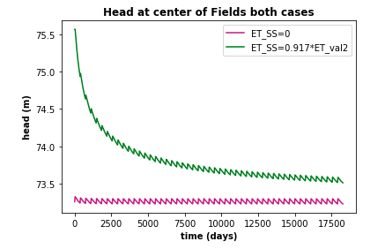
ET_SS equals 0 and ET_SS is 0.917*ET_val2 for 30 and 50 years
Q2

Slide 9
.

Slide 10
SS_ET for the two transient scenarios. 16 yr at center of ET_zone (2 stress periods-ie transient 1 and 3 stress periods-ie transient 2)
Q2&Q3

Slide 11
SS_ET for the two transient scenarios (16 yr each ) at center of model domain
Q3

Slide 12
Q3
.
2 stress periods
3 stress periods

